Slide 1
Rossmann sales analysis

Slide 2
Data Source
Data was provided by Rossmann to Kaggle for predicting Sales.
Rossmann operates over 3,000 drug stores in 7 European countries.
Dataset contains details for 1115 stores over a period of 3 years.

Slide 3
DATA description
Data contains 18 attributes which are continuous, discrete and binary.
It contains 100K records for each day for the duration 2013 to 2015.

Slide 4
Hypothesis
If the promotion is for more than a day the sales is more relative to a single day promotion.
If the promotion is for more than a day the number of customers increases relative to a single day number of customers.
If the assortment(“type c”) is extended the sales would be more as compared to basic and extra.
If the competition store is opened for less than a year then the sales are more as compared to competitor stores opened more than a year.

Slide 5
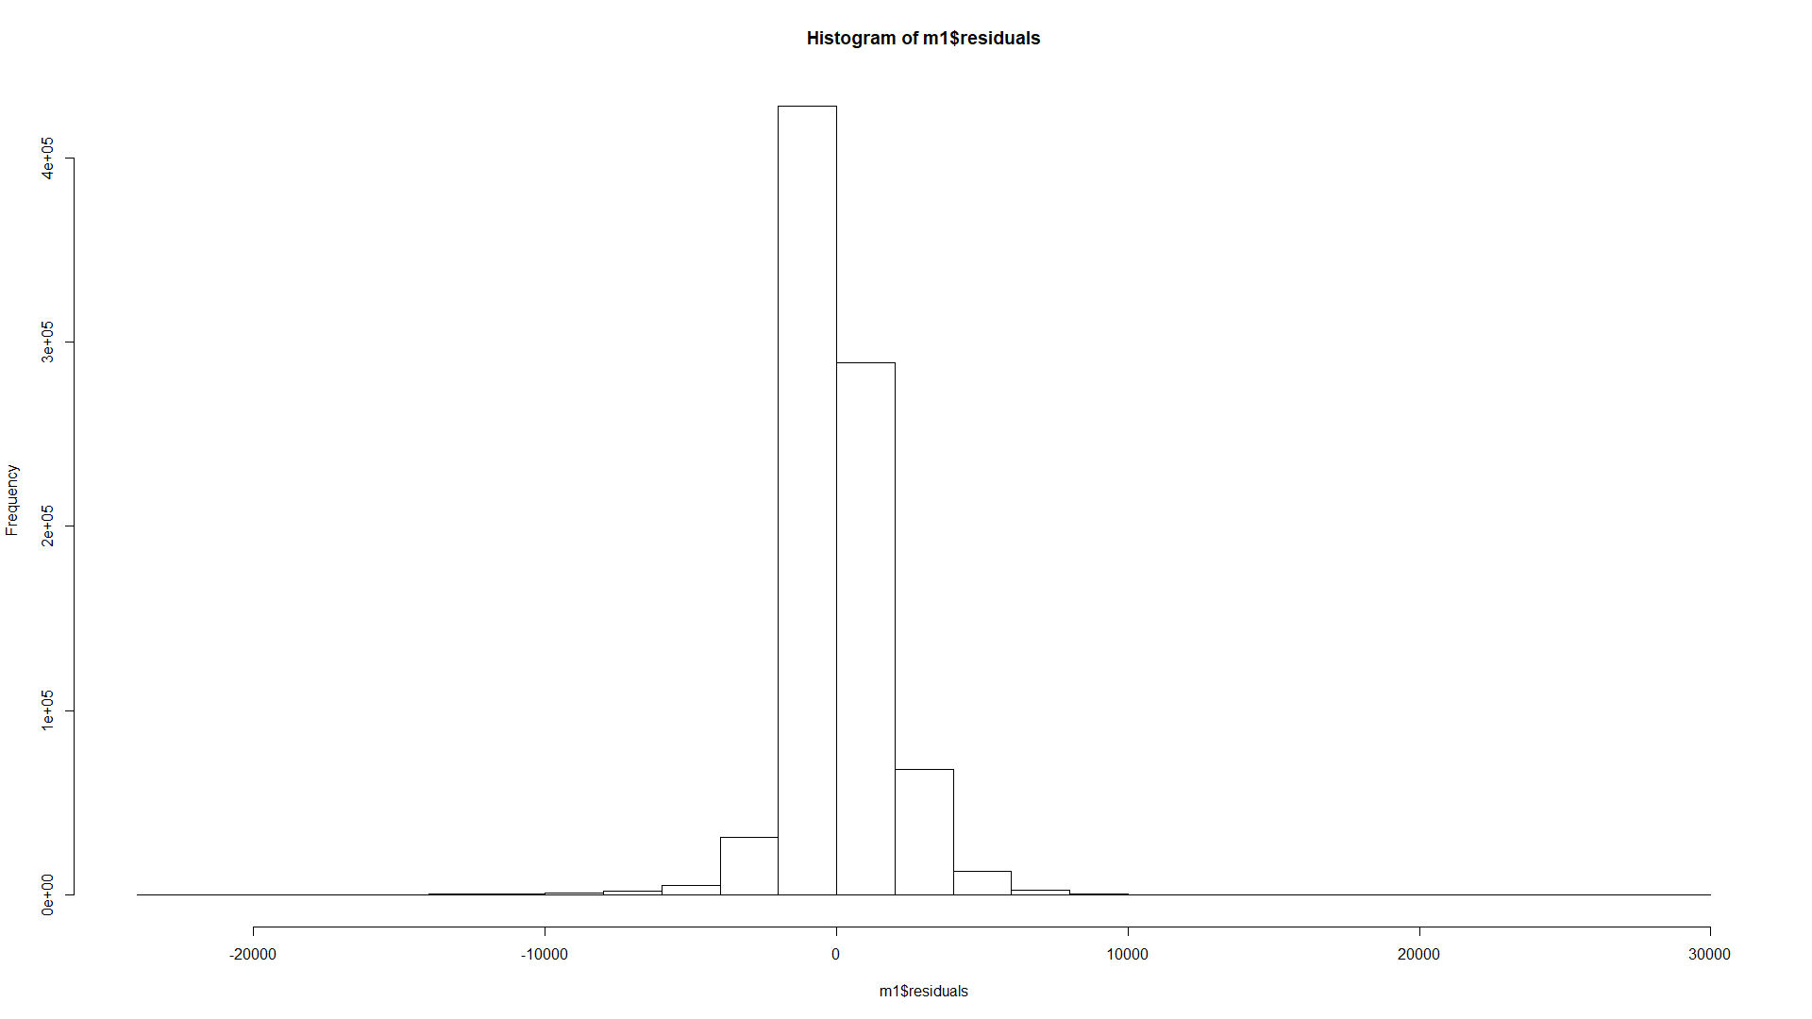
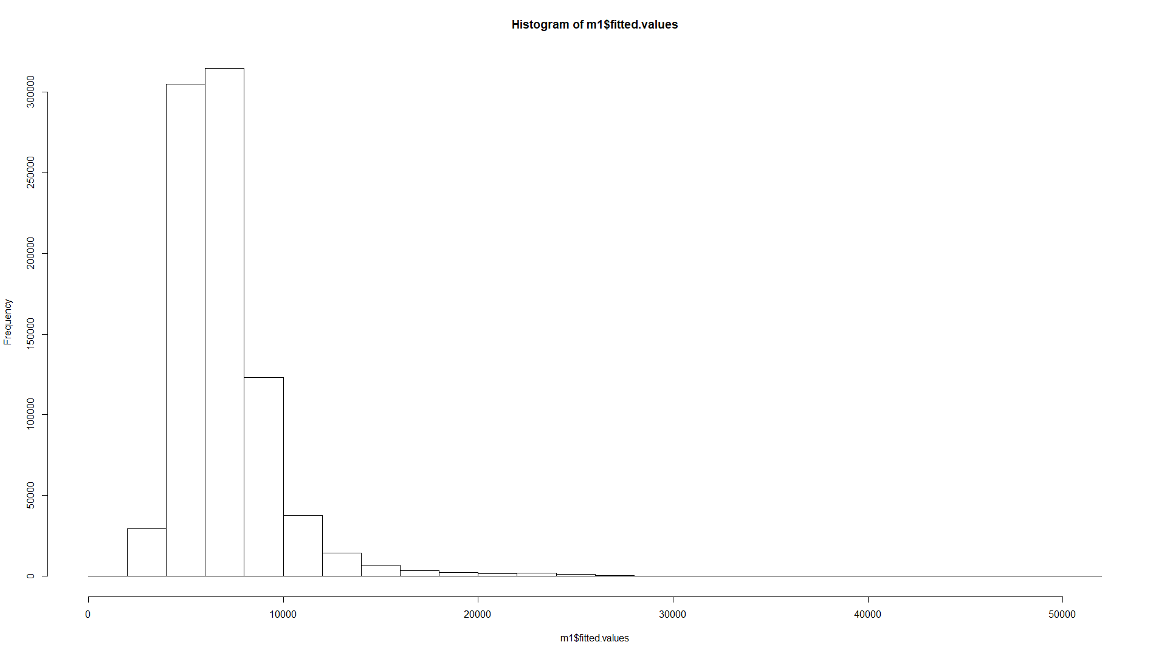
Histograms
RESIDUALS
FITTED VALUES

Slide 6
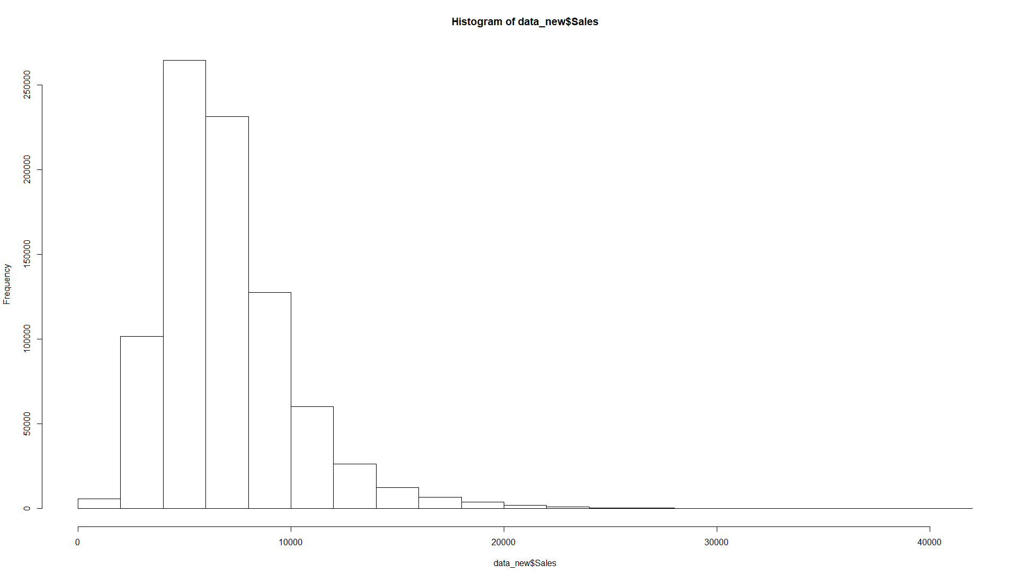
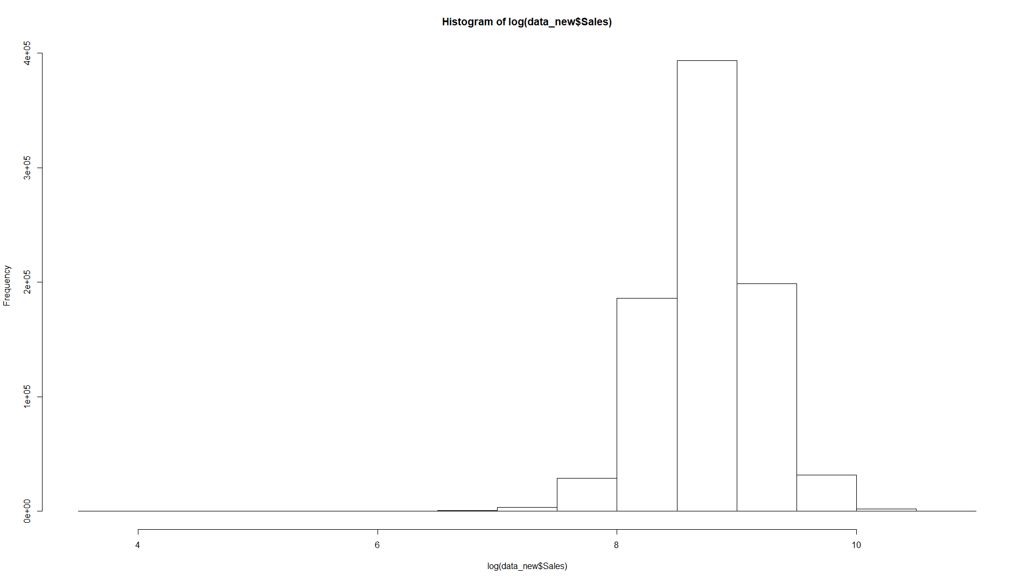
Dependent Variable Analysis
Y Variable: SALES
Log Transformation SALES

Slide 7
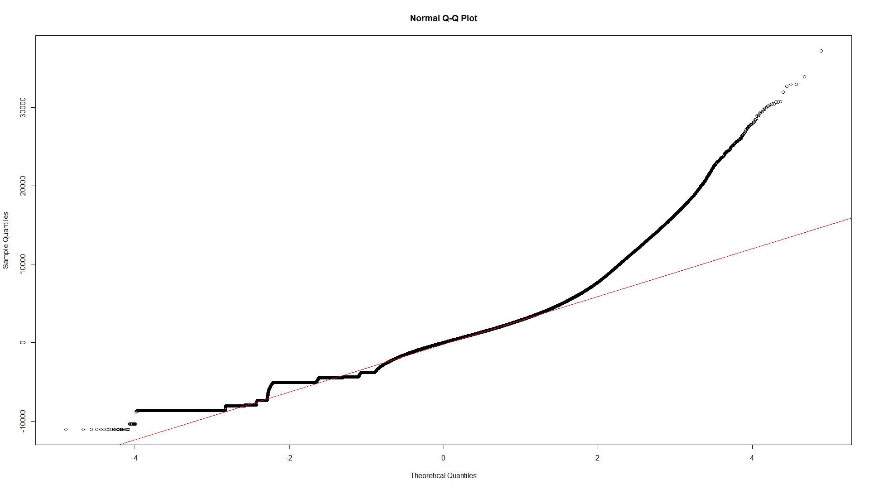
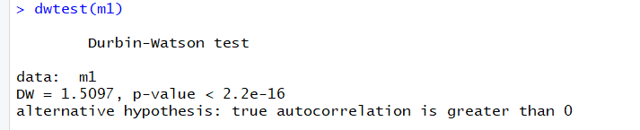
OLS Assumptions
Linearity
Auto Correlation

Slide 8
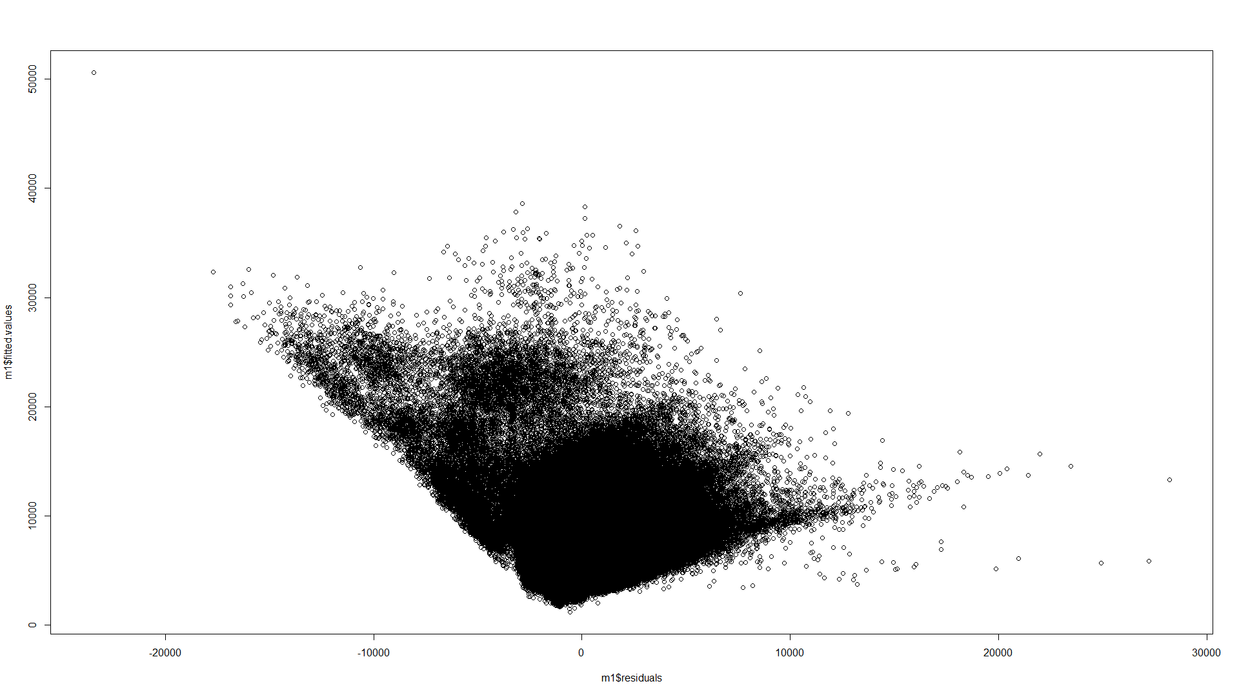
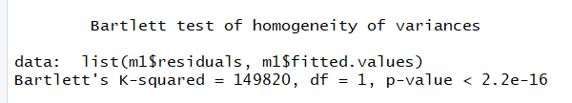
Homoskedasticty Assumption
Test for homoskedasticty

Slide 9
Solution
Since the OLS assumptions are violated the solution for it is ???
Looking at data it is suitable for which analysis?

Slide 10
Thank You!

